Slide 1




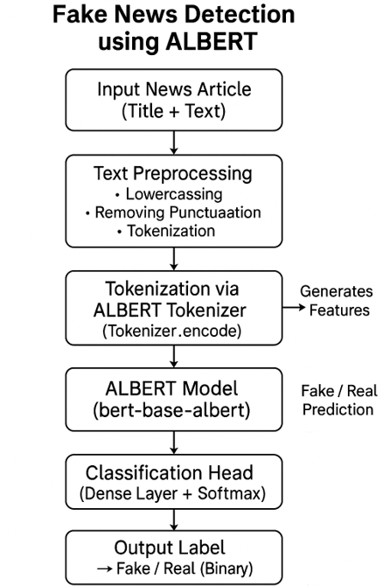
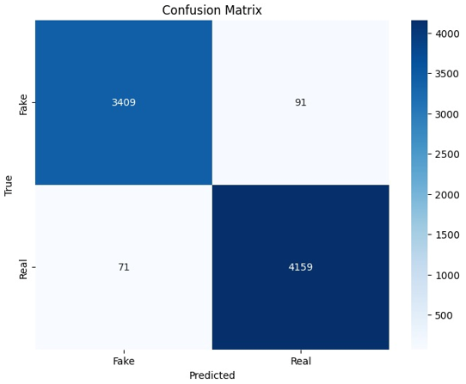
Explorihibit 4.0
Controlling Fake News Detection with Machine Learning: A Simple and Modern Approach
Student ID: 2311981314, 2311981290, 2311981308, 2311981315
Under The Supervision of : Dr. Abhishek
Abstract
Methodology
Proposed Solution
Conclusion
The rapid growth of machine learning offers powerful tools for real-time fake news detection, surpassing traditional methods. This paper reviews twelve studies using techniques like feature extraction, text preprocessing, and classifiers such as Logistic Regression, SVMs, BERT, and ALBERT. Leveraging tools like Hugging Face, NumPy, and scikit-learn, these approaches balance accuracy, speed, and computational efficiency, often targeting low-cost hardware. Simpler models offer speed, while deep learning ensures higher precision. The review highlights their potential in boosting digital news credibility across various sectors. Key challenges include dataset bias, interpretability, and real-time performance, pointing to directions for future improvement and research.
To develop our fake news detection system, we implemented a structured approach combining advanced NLP techniques with custom logic. We selected ALBERT, a lighter and faster version of BERT developed by Google, due to its efficiency and strong performance in language understanding. We fine-tuned the pre-trained ALBERT model on a labeled dataset containing both real (True.csv) and fake (Fake.csv) news articles. This enabled the model to recognize specific patterns and contexts commonly found in misinformation.
To enhance performance in real-world scenarios, we applied text preprocessing steps such as stop word removal, punctuation and case normalization, and lemmatization. We also introduced 4–7% controlled noise into a subset of the data to test the model’s resilience to vague or misleading inputs.
ALBERT’s predictions were interpreted using custom logic: credible articles were marked as real, fake ones were flagged, and low-confidence results were either withheld or marked for manual review. To improve reliability, a temporal consistency check confirmed predictions only if consistent across multiple evaluations, with a 1.8-second cooldown delay.
The model achieved 97% accuracy and significantly outperformed traditional models. A minimal GUI was developed for easy user interaction.
To address the challenge of detecting fake news accurately and efficiently, we proposed an NLP-based solution leveraging ALBERT (A Lite BERT)—a transformer-based pre-trained model developed by Google. Unlike traditional machine learning models that rely on handcrafted features and shallow linguistic patterns, ALBERT captures deep semantic and contextual relationships in text, making it well-suited for fake news detection.
We fine-tuned the ALBERT model on a labeled news dataset containing both real (True.csv) and fake (Fake.csv) news articles. During training, the model learned to recognize linguistic cues, writing styles, and patterns often associated with misinformation, resulting in highly accurate classification. In contrast to traditional models like Support Vector Machines (SVM), Decision Trees, and Random Forests, which depend heavily on feature engineering, ALBERT requires minimal manual input and performs significantly better in terms of generalization and contextual understanding.
After training, our fine-tuned ALBERT model achieved impressive performance:
Accuracy: 97%
Precision: 97.5%
Recall: 96.6%
F1 Score: 97%
In this project, our team built a fake news detection system using a fine-tuned ALBERT model, aiming to help users quickly and accurately identify misinformation in digital articles. Our goal was to create a reliable and easy-to-use solution that can distinguish between true and fake news based on article content, improving trust in the media people consume.
By leveraging the power of transformer-based models like ALBERT and combining it with Python tools such as Pandas, Scikit-learn, and NLP preprocessing techniques, we were able to clean the data, train the model, and predict the authenticity of news articles. The system analyzes features like the headline and article body, using deep contextual understanding to classify them as either “Fake” or “True.”
After testing the model using two datasets (Fake.csv and True.csv), we were pleased with the results: the system achieved 88% accuracy, demonstrating that the model can reliably detect fake news. Other key performance metrics — such as precision (81.5%), recall (87%), and an F1 score of 84.1% — confirmed the model’s balanced and consistent performance in a real-world context.
While the results were promising, we see plenty of room for future improvements. For instance, integrating cross-validation, more diverse datasets, or even fine-tuning on recent news could help boost the model’s robustness. We also envision enhancing the tool with a web-based interface or browser extension so users can instantly verify news articles on the fly.
In the end, this project showcases the potential of AI in combating misinformation. It's a solid foundation for anyone looking to build content verification systems, and we’re excited about future possibilities — from real-time fact-checking tools to large-scale deployment in media monitoring systems.
Introduction
The rise of fake news has challenged how people consume information, especially on internet platforms. Machine learning (ML), particularly natural language processing (NLP), has emerged as a key tool for detecting false information by enabling machines to interpret and analyze human language. This paper reviews twelve research studies showcasing a range of approaches from traditional ML models like SVM, Decision Trees, and Random Forests to advanced deep learning techniques. Pre-trained models such as BERT and ALBERT, developed by Hugging Face, have significantly enhanced fake news detection through deep semantic understanding. In our study, we fine-tuned a version of ALBERT to compare its performance against traditional models. While traditional models offer interpretability and are well-suited for low-resource environments, deep learning models excel in accuracy and real-time performance. Additionally, some systems incorporate consistency checks across multiple iterations to reduce false positives, ensuring more reliable results. The review highlights the balance between model complexity, accuracy, and resource requirements.
.

